Slide 1
Working with database

Slide 2

Agenda
Building web application using JDBC
Handling Exception
Using JNDI with JDBC
Using ServletConfig in an application
Using ServletContext
Understanding JPA

Slide 3
JDBC Revisited
JDBC provides a standard library for accessing relational databases
– API standardizes
• Way to establish connection to database
• Approach to initiating queries
• Method to create stored (parameterized) queries
• The data structure of query result (table)

Slide 4
JDBC Revisited
JDBC provides a standard library for accessing relational databases
– Determining the number of columns
– Looking up metadata, etc.
– API does not standardize SQL syntax
• JDBC is not embedded SQL
– JDBC classes are in the java.sql package
• Note: JDBC is not officially an acronym;
unofficially, “Java DataBase Connectivity”

Slide 5
JDBC Drivers
JDBC consists of two parts:
– JDBC API, a purely Java-based API
– JDBC Driver Manager, which communicates with
vendor-specific drivers that perform the real communication
with the database.
• Point: translation to vendor format is performed on the client
– No changes needed to server
– Driver (translator) needed on client

Slide 6
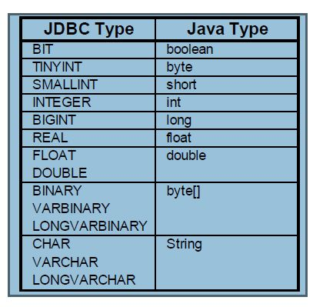
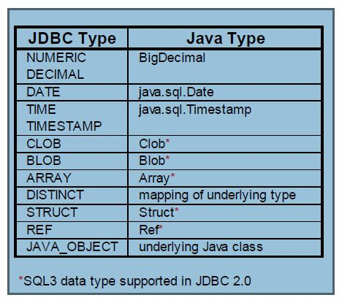
JDBC Data Types

Slide 7
Seven Steps in JDBC
1. Load the driver
2. Define the Connection URL
3. Establish the Connection
4. Create a Statement object
5. Execute a query
6. Process the results
7. Close the connection

Slide 8
Using Metadata
System-wide data
– connection.getMetaData().getDatabaseProductName()
– connection.getMetaData().getDatabaseProductVersion()
• Table-specific data
– resultSet.getMetaData().getColumnCount()
• When using the result, remember that the index starts at 1, not 0
– resultSet.getMetaData().getColumnName()

Slide 9
Using Metadata(Example)
public class NorthwindServlet extends HttpServlet {
public void doGet(HttpServletRequest request,
HttpServletResponse response)
throws ServletException, IOException {
response.setContentType("text/html");
PrintWriter out = response.getWriter();
… out.println(docType + …);
String driver = "sun.jdbc.odbc.JdbcOdbcDriver";
String url = "jdbc:odbc:Northwind";
String username = "";
String password = "";
String tableName =
request.getParameter("tableName");
if ((tableName == null) || (tableName.equals("")))
{
tableName = "employees";
}
showTable(driver, url, username, password,
tableName, out);
out.println("</CENTER></BODY></HTML>");

Slide 10
Using Metadata(Example) cont
private void showTable(String driver,
String url,
String username,
String password,
String tableName,
PrintWriter out) {
try {
Class.forName(driver);
Connection connection =
DriverManager.getConnection(url, username,
password);
DatabaseMetaData dbMetaData =
connection.getMetaData();
out.println("<UL>");
String productName =
dbMetaData.getDatabaseProductName();
out.println(" <LI><B>Database:</B> " +
productName);
String productVersion =
dbMetaData.getDatabaseProductVersion();
out.println(" <LI><B>Version:</B> " +

Slide 11
Using Metadata(Example) cont
Statement statement = connection.createStatement();
String query =
"SELECT * FROM " + tableName;
ResultSet resultSet = statement.executeQuery(query);
out.println("<TABLE BORDER=1>");
ResultSetMetaData resultsMetaData =
resultSet.getMetaData();
int columnCount = resultsMetaData.getColumnCount();
out.println("<TR>");
for(int i=1; i<columnCount+1; i++) {
out.print("<TH>" +
resultsMetaData.getColumnName(i));
}
out.println();
while(resultSet.next()) {
out.println("<TR>");
for(int i=1; i<columnCount+1; i++) {
out.print("<TD>" + resultSet.getString(i));
}
out.println();
}

Slide 12
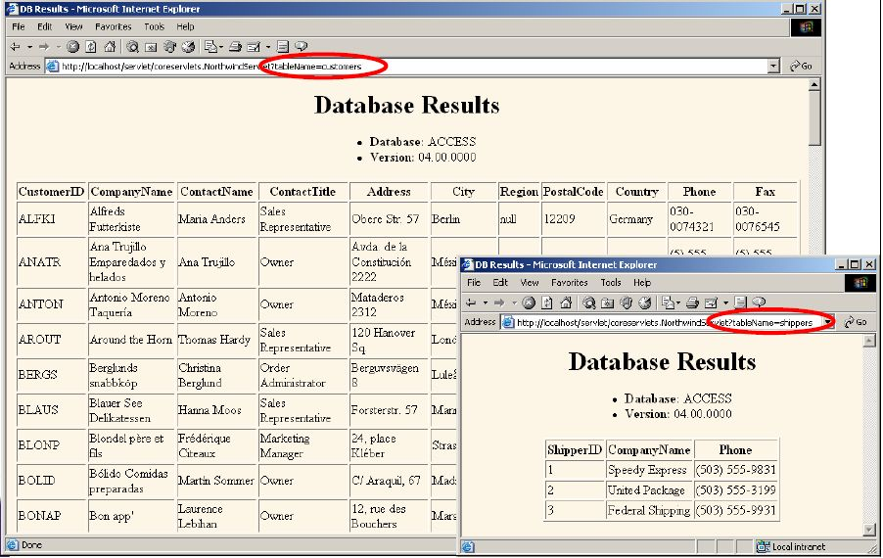
Using Metadata Output

Slide 13
Using JNDI
• Idea
– Use abstract name to get connection from a data source
• Advantages
– Lets you change data source without changing code
– Available in multiple Web apps
• Disadvantage
– Requires server-specific registration of data source
• Code for steps 1-3 replaced by:
Context context = new InitialContext();
DataSource dataSource = (DataSource)context.lookup
("java:comp/env/jdbc/dbName");
Connection connection = dataSource.getConnection();

Slide 14
Configuring DataSource for JNDI
Inside tomcat_dir/conf/server.xml
<DefaultContext reloadable="true">
<Resource name="jdbc/Northwind" auth="Container"
type="javax.sql.DataSource"/>
<ResourceParams name="jdbc/Northwind">
<parameter>
<name>factory</name>
<value>
org.apache.commons.dbcp.BasicDataSourceFactory
</value>
</parameter>
<parameter><name>driverClassName</name>
<value>sun.jdbc.odbc.JdbcOdbcDriver</value>
</parameter>
<parameter><name>url</name>
<value>jdbc:odbc:Northwind</value></parameter>
<parameter><name>username</name>
<value></value></parameter>
<parameter><name>password</name>
<value></value></parameter>

Slide 15
Transactions
Tranactions
– By default, after each SQL statement is executed the
changes are automatically committed to the database
– Turn auto-commit off to group two or more statements
together into a transaction
connection.setAutoCommit(false)
– Call commit to permanently record the changes to the
database after executing a group of statements
– Call rollback if an error occurs

Slide 16
Transactions example
Connection connection =
DriverManager.getConnection(url, username, passwd);
connection.setAutoCommit(false);
try {
statement.executeUpdate(...);
statement.executeUpdate(...);
connection.commit();
} catch (Exception e) {
try {
connection.rollback();
} catch (SQLException sqle) {
// report problem
}
} finally {
try {
connection.close();
} catch (SQLException sqle) { }
}

Slide 17
Transactions
• getAutoCommit/setAutoCommit
– By default, a connection is set to auto-commit
– Retrieves or sets the auto-commit mode
• commit
– Force all changes since the last call to commit to become
permanent
– Any database locks currently held by this Connection
object are released
• rollback
– Drops all changes since the previous call to commit
– Releases any database locks held by this Connection object

Slide 18
Using ServletConfig and Servlet
Use ServletConfig for Servlet Specifc Information
Use ServletContext for Application Specific Information
Configure Driver Information
Configure URL information
Use ServletConfig to read the data from init parameter
Use ServletContext to read the data from context parameter

Slide 19
Introduction to JPA
• What is ORM
Become acquainted with the Java Persistence API (JPA)
• Learn how to setup and use JPA

Slide 20
What is ORM
•ORM stands for Object Relational Mapping
POJO’s directly mapped to Database tables
ORM framework takes care of
Synchronization
Transaction
Performance
Database Independence

Slide 21
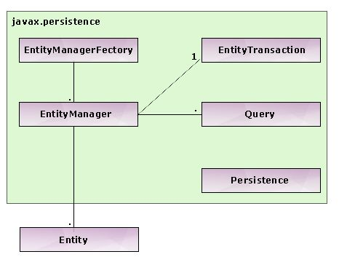
JPA Architecture

Slide 22
Main Components of JPA
•Entity Classes
• Entity Manager
– Persistence Context
• EntityManagerFactory
• EntityTransaction
• Persistence Unit
– persistence.xml
• Java Persistence Query Language
(JPAQL)
– Query

Slide 23
Persistence Unit
•Defines all entity classes that are managed by JPA
• Identified in the persistence.xml configuration file
• Entity classes and configuration files are packaged together
– The JAR or directory that contains the persistence.xml is called the root of the persistence unit
– Needs to be inside a META-INF directory
• Whether or not inside a jar

Slide 24
Benefits of ORM
•No need to deal with the SQL Queries to save and retrieve the data
•Simple configuration
•Standardized API to persist the business objects
•Fast development of application
•Concurrency support
•Excellent cashing support for better performance of the application
•Injected transaction management
•Configurable logging
•Easy to learn and use

Slide 25
Drawback of ORM
•Slow performance in case of large batch updates
• Little slower than JDBC

Slide 26

Summary
We can connect directly to the database or to a database registered in an Directory Service
Use init parameter and Context parameter for database specific configuration information
JPA is a standard ORM specification
JPA can take care of boiler plate code like
Try catch block
Obtaining Connection
Mapping of Datatypes
Synchronizing models with tables

